Slide 1
Travel Expense Report in PeopleSoft
SVC Business Office

Slide 2
Creating an Expense Report
Expense reports are created after returning from travel, either to request reimbursement for expenses, or to clear a cash advance.
An Expense Report cannot be processed prior to the identified travel dates on the document.

Slide 4
Create a New Travel Expense Report
First go to Navigation (Nav Bar) on the upper right corner, click on it and it will give you a drop down menu of your options..
Select “employee self service” from your menu options.
“travel and expenses” > “expense reports” >“create/modify”

Slide 5
Creating an expense report
When creating any new expense report, you will first be asked to select an Employee ID (EMPLID). This should default to the user signed in.

Slide 6
Creating an expense report
When you first create a new Expense Report, you will see an upper section of header fields and a lower section for “Expenses” that make up the ER lines:

Slide 7
Creating an expense report
Use the ER header fields to select a pre-defined Business Purpose for the ER, a free text document description, and a default location (used to calculate per diem rates. You can also add attachments in the header:
Unlike Travel Authorizations, Expense Reports don’t have dates in the Header section. They do have individual Line item dates.

Slide 8
Creating an expense report
You can start working on ER lines by filling in each line item, using the plus/minus buttons to add or remove lines as you go along:
Or you can use the Quick-Fill feature to populate multiple lines at once:

Slide 9
Creating an expense report
Sometimes, the fields you have available to use will change based on the Expense Type you select, bringing in new optional and/or required fields:

Slide 10
Creating an expense report
Once an Expense Type is selected for a given line, a collapsed section for “Accounting Details” will also become visible. This is where a Traveler will enter/ update the funding distribution that’s intended for be used for that line:

Slide 11
Creating an expense report
Clicking on the expand triangle will open the Chartfield block, which will already be populated with default values, you must change these values:

Slide 12
Creating an expense report
Expense Reports are unique in that line items can be flagged as “Non-Reimbursable”. Using this feature for line items like registration or airfare that are paid for by a PCard allows them to be included to show the total cost of travel without impacting any true reimbursements due to the Traveler:

Slide 13
Creating an expense report
Once you have finished entering Header, Line, and Distribution information, you can save your ER by clicking on the Save for Later button:
This will assign the ER a Report ID number and set it to a “Pending” status:

Slide 14
Creating an expense report
You can make changes and periodically save the ER as you are working on it, but once you are ready to submit the ER for approval you will need to click on the Summary and Submit button:
This will take you to a new page with an overview of the different line items that have been entered for the ER.

Slide 15
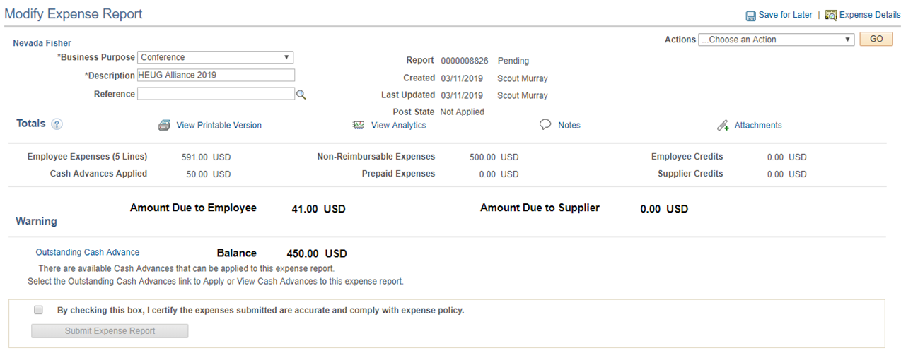
Submitting an expense report
From the Summary and Submit page you can also print a copy of the ER, add text-based notes, or add/review attachments that have been added to the ER:

Slide 16
Submitting an expense report
The Summary and Submit page requires the submitter to check a certification box before they can submit their ER and confirm their submittal:
You must check the box before you are able to submit the expense report.

Slide 17
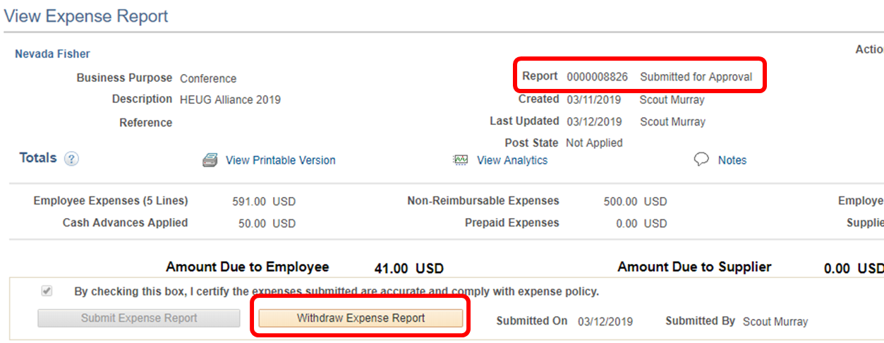
Submitting an expense report
Expense Reports that have been successfully submitted are given a “Submitted for Approval” status. If the submittal was accidental or a needed change is recognized, the Traveler can withdraw their ER from the approval process:

Slide 18
Submitting an expense report
The ER Summary and Submit page will also show a graphic and log that shows where in the approval process it is and any approval history:

Slide 19
Approving an expense report
T&E approvers are able to get to the transaction specific approval page a few different ways:
Through a link in a notification email sent to them
Through their Worklist
Through the T&E Approve Transactions screen
The first two options depend on whether the approver is an “Email User”, a “Worklist User”, or both. Users are both by default, and will get email notifications and be able to see pending items on their Worklist.

Slide 20
Approving an expense report
There are different options an Approver will have depending on how the local T&E approval process is configured:
Approve/Review – Positive action; approving/reviewing a T&E document will move it forward in the approval queue.
Deny – Negative action; denying a T&E document permanently terminates it. It cannot be resubmitted. Approver must include a comment.
Send Back – Negative action; sending a T&E document back ends the approval process but allows an authorized user to make changes to the document and/or resubmit it. Approver must include a comment.
Hold – Neutral action; holding a T&E document prevents it from being processed any further through approvals until the Approver releases it by taking a different approval action (e.g. Approve, Send Back).

Slide 21
Approving an expense report
Regardless of the method used to select an item for approval, the ER approval page is the same. The page is divided up into several different sections:
General Information – Header information
Totals – Summary totals for the document
Approval History – Approval activity information
Comments – Approver Comment information
Actions – Where Approvers will make an approval action
Receipt Information – Only used with Receipt Verification
Expense Line – Line info and links to Distribution info

Slide 22
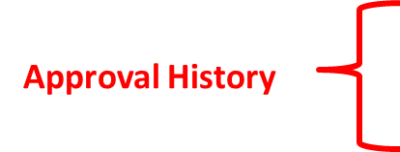
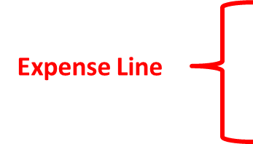
Approving an expense report

Slide 23
Approving an expense report
The Expense Report approval page is a little different from the one for Travel Authorization in terms of how you get to line item details. This can be done by clicking on one of the “Expense Details” links on the screen:

Slide 24
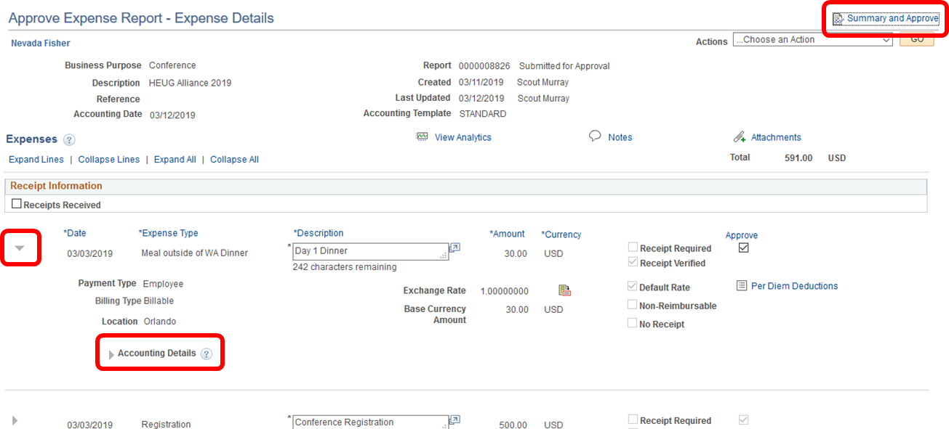
Approving an expense report
The line items on the Expense Details page can be expanded to see additional line and distribution information:

Slide 25
Budget checking an expense report
Before you can make an approval action you will need to run budget checking. To run the Budget Check from the approval screen, click on the Budget Options link text.

Slide 26
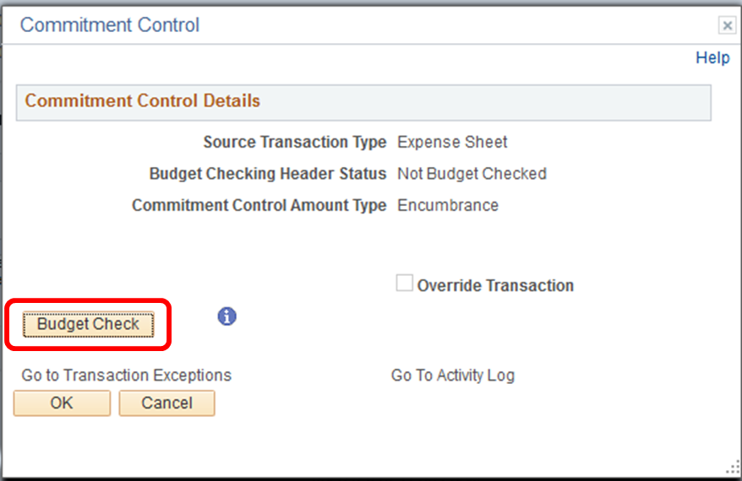
Budget checking an expense report
Clicking the Budget Options link text will bring up Commitment Control window. From there, click on the Budget Check button:

Slide 27
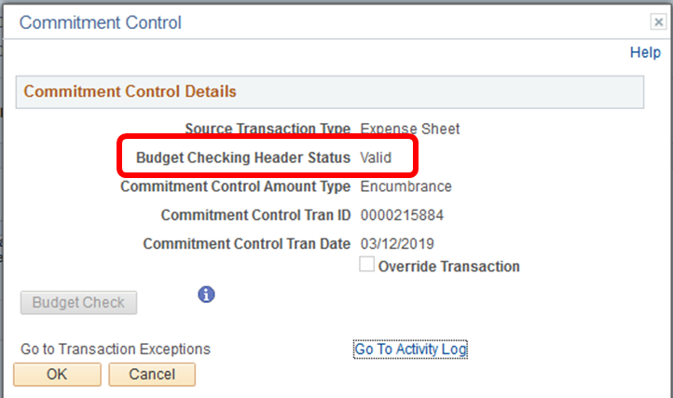
Budget checking an expense report
If the document passes budget checking it will return a “Valid” or “Warning” Budget Checking Header Status. If the transaction returns with an “Error” status, it will need to be sent back to the Traveler for correction or a budget adjustment will need to be made:

Slide 28
Budget checking an expense report
Once a document has passed budget checking, the Approver will be able to take one of their available approval actions:

Slide 29
Questions?

