Slide 1
Chart of Accounts
Accounting Changes for CTCLink
September 2021

Slide 2
Changes for ctcLink/Peoplesoft
What does the new accounting structure look like
What is new
What isn’t changing
What is changing
Budgeting
Item Types

Slide 3
CTCLink
It will impact everyone…
Business Processes
Travel
Purchasing
Budgets
Reports

Slide 4
CTCLink

Slide 5
What is new?
Business Unit: WA040 (standard for all SVC transactions)
Operating Unit: 7040 (standard for all SVC transactions)
State Purpose: created to identify expenses that are IT related – required field for all expenditures.
  N - null (no)
  Y - yes

Slide 6
What is new?
For Grants and Capital Projects…
Project Costing Business Unit: WA040
Project ID: required if using Fund 145, assigned in the Grants module by the Business Office
Activity: required if a Project ID is used, it defines a specific task within a grant

Slide 7
What isn’t changing?
Current “Legacy” structure for an expense:
Fund. Prog. Org. Subobject (ex. 149-082-1820-EA)
Fund is still fund
  148 is still 148, 149 is still 149, etc
  But, if it has an appropriation, then it has both an appropriation and fund. This is used by state allocated Funds – 001, 057, 060, 24J.
‘Prog’ is now called “Class”- that’s all for most progs – see next slide
  061 is still 061

Slide 8
What is changing?
A few ‘prog’s’ will change:
  280 becomes 286
  281 becomes 287
  All capital 9xx becomes 901
‘Org’ will be ‘dept’
  All new 5 character numeric values
Subobject and Revenue Source will be ‘Account’
  All new 7 character numeric values, lots more
New structure for an expense or revenue
Fund. Class. Dept. Account

Slide 9
What is changing?
If an expenditure uses a fund that requires an appropriation, then Fund and Appropriation chartfields are both required, examples:
Appropriation Fund
101 001
123 001
071 24J
R10 147
C19 057 (various other approps)
A16 060 (various other approps)

Slide 10
So what do the new Dept’s look like?
Organized using a numeric structure related to campus organization to help with reporting
  First digit
1
Executive/President
2
Administrative Services
3
Instruction
4
Student Services
5
College Advancement
6
Capital Projects
7
Grants & Contracts
8
Financial Aid Awards & Scholarships
9
Fiscal / Statewide Global Departments

Slide 11
What does the dept crosswalk look like?
Full SVC Chart of Accounts/Department crosswalk located on Business Office Portal

Slide 12
All General Ledger Codes will be Accounts
Coding structure of new General Ledger Codes
First digit:
1 – Assets
2 – Liability
3 – Equity
4 – Revenue
5 – Expense
Based on financial statement format
1, 2 and 3 are balance sheet accounts
4 and 5 are income statement accounts

Slide 13
New “account” values
Replaces revenue and source
  New unique values for different revenue sources
Replaces expenditure and sub-object
  New unique values for expenditure and sub-object combinations

Slide 14
Revenue account values
Replace revenue and source: fairly close
Two fields will now be one

Slide 15
Expenditure Account Values
Replaces expenditure and sub-object
Two fields will now also be one

Slide 16
Sub-objects will be Accounts

Slide 17
Budgeting
Budgets will be entered in “kk”, or commitment control
All salary budgets will be combined by classification in each budget number string
  No longer able to use positional budgeting (AK.01)
  Basically, all AK’s will be only budget line item
  Same for all Admin/Exempt and Faculty
All other budgets will be the same

Slide 18
Budgeting
Cannot create an expense without a budget, even if the budget is zero, still needs to be added manually
  This will take time as we work through the process
  If it is a grant in Fund 145, budget must be a dollar amount – not zero
Reports are still being developed by SBCTC and the College
When a requisition is entered, it is in ‘pre-encumbered’ status, and Peoplesoft will account for that
Once it is turned into a PO, it moves from “pre-encumbered” to “encumbered”
Once PO is paid by Accounts Payable, it moves to an expenditure

Slide 19
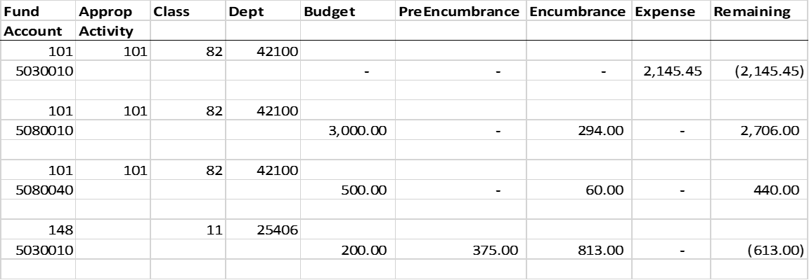
Budgeting
Example of a query budget status report from UAT

Slide 20
Item types
Replaces both legacy fee codes (for students) and Financial Aid Program Codes, mostly
Has both a debit and a credit
Used in Campus Solutions Student Finance
  Tuition, fees and other student charges
  Payment Types
  Waivers
  Deposits
  Financial Aid

Slide 21
Item Type Numbering Structure
12 Digit Number, Begins with:
0 – Conversion item type (everything fall 2019 and older)
1 – Tuition charges
20 – Term Fees (Facilities fee, matriculation fee, Technology fee)
21 – Class Fees
22 – Course Fees
3 – Misc fees (Child Care, Fitness Center, etc)
4 – Collections, Payment Plan, Third Party Charges
5 – Refund Methods, other misc in cashiering

Slide 22
Item Type Numbering Structure
12 Digit Number, Begins with:
6 – Payment item types including waivers, third party, etc
7 – Payment item types for cash, check, credit card
9 – Financial Aid Payments

Slide 23
Wrap Up
This presentation, along with other info will be available at: https://skagit.sharepoint.com/sites/portal/administrative-services/business-office/
We are still working through many of the processes
We don’t have the answers to everything…..yet
We are still working on the best mechanism for reporting
It will likely take us several months to refine our processes, so please be patient
We can do this!

Slide 24
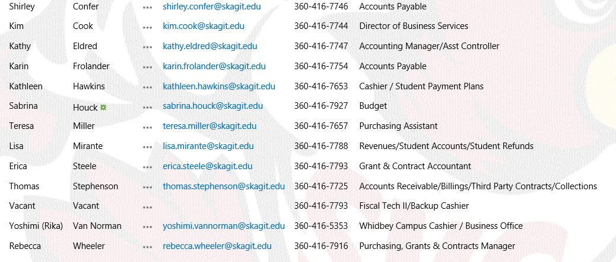
For further questions, please contact the Business office

