Slide 1
Activate Your ctcLink Account

Slide 2
Step 1
Open an internet browser and go to the Skagit Valley College website: www.skagit.edu

Slide 3
Step 2
Click on the ctcLink icon.
Note: the icon will appear after Oct. 11.
You can also access ctcLink using this web address: https://gateway.ctclink.us/

Slide 4
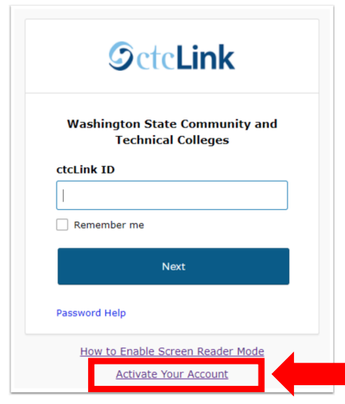
Step 3
Click Activate Your Account at the bottom of the page. Then click on OK when the redirection pop-up message displays.

Slide 5
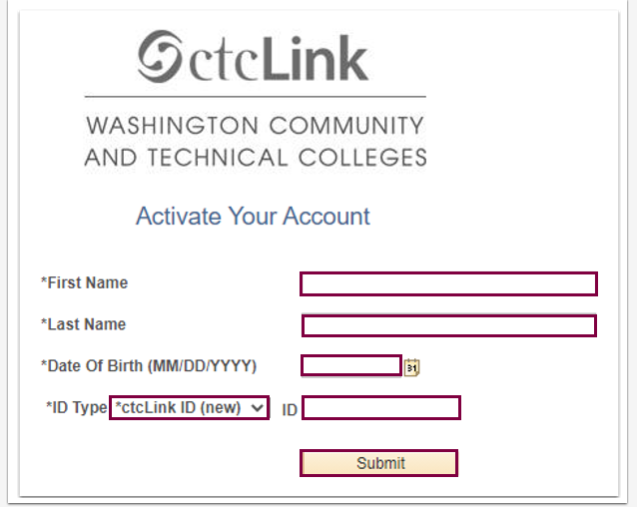
Step 4
Enter the information as requested and click Submit.
New Student or Employee: Enter your 9 digit ctcLink ID also known as EMPLID.
Returning Student or Employee: Enter your 9 digit SID.

Slide 6
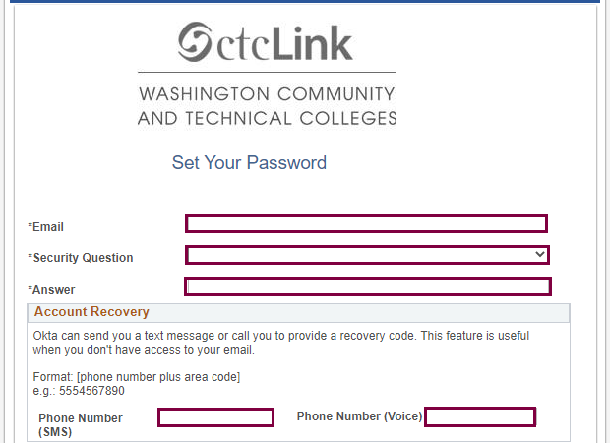
Step 5
Enter the following:
SVC Email Address
Security Question
Answer to Security Question
Phone Number – for text messages
Phone Number – for voice calls
IMPORTANT: Write down the information that you entered or take a screenshot. These are needed for account recovery. The security question is NOT case sensitive.

Slide 7
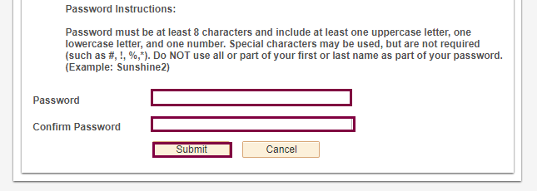
Step 6
Create your ctcLink password and confirm. Then click Submit.
Passwords must contain 8 characters, including upper and lower case and a number or special character.

Slide 8
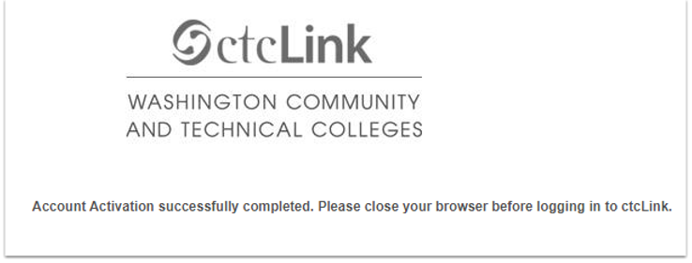
Step 8
You will receive a confirmation message which will include your ctcLink ID also known as your EMPLID. Write this down. Click OK. Your ctcLink ID (EMPLID) will replace your SID.

